Slide 1
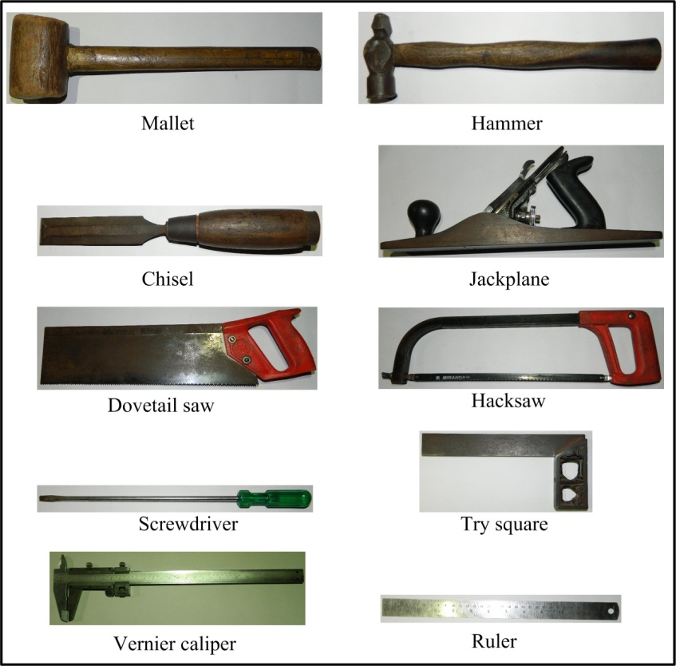
Some Tools of workshop

